Slide 1
Problem solving and critical thinking

Slide 2

Some feedback about presentations

Slide 3

Issue 1: First two minutes of presentation
First two minutes: Make or break
Elevator pitch:
Think about convincing someone in
elevator
Short, seamless and impactful summary
of your work:
Write this summary down, rephrase it to describe your work better
Must answer two questions(and no more)
What problem are you solving
How are you different from others

Slide 4
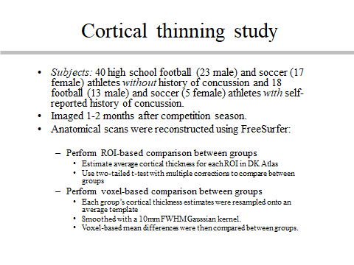
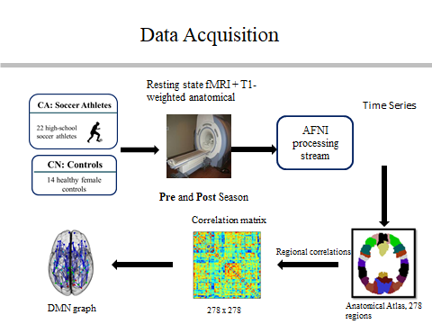
Issue 2: Textual vs visual information

Slide 5
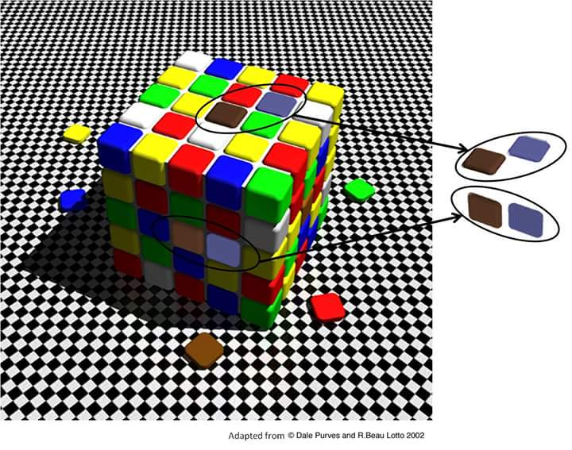
Textual vs visual information
Always prefer graphics over text in presentations
No slide with more than 15 words of text

Slide 6
Other issues
No engagement with audience
Multiple people answering/speaking at once

Slide 7
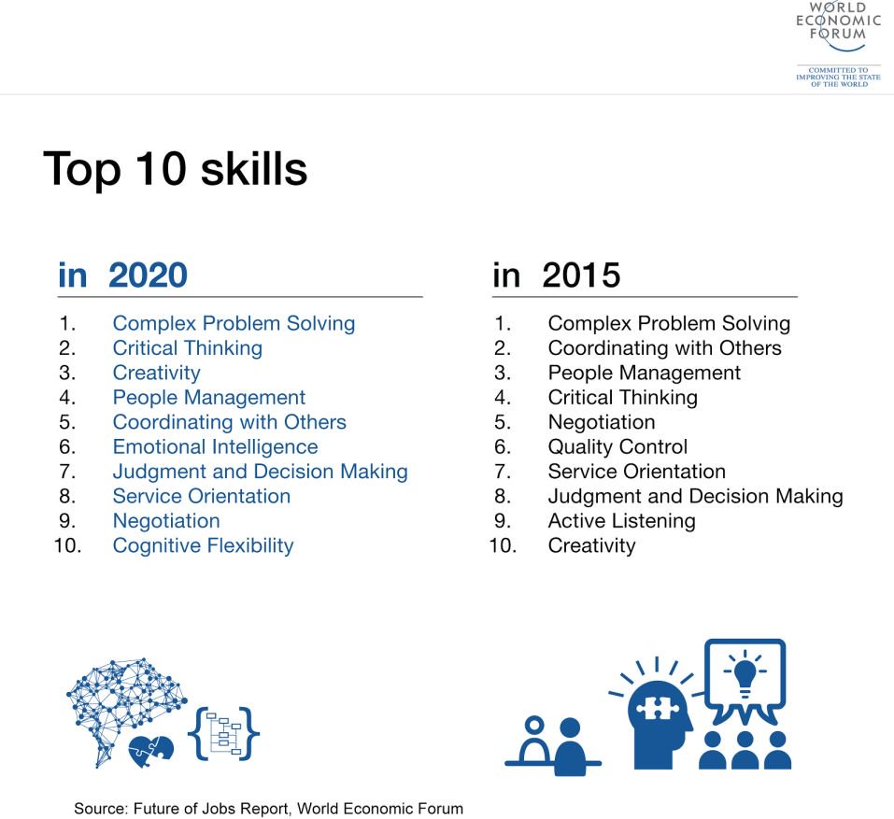
Problem solving: Why should we care?

Slide 8

Cowlar: Cow IoT

Slide 9
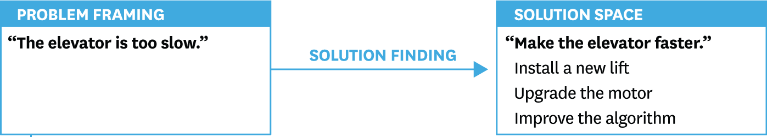
Problem solving: examples

Slide 10
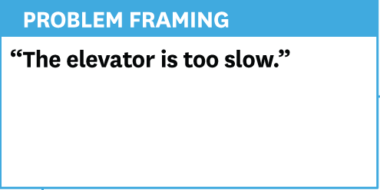
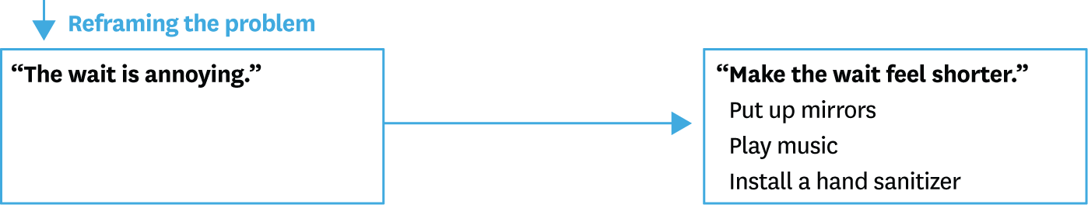
Problem solving: examples

Slide 11
Critical Thinking
A kind of thinking in which you
Question
Analyze
Interpret
Evaluate,
and make judgement about what you
Read
Hear
Say, or
Write

Slide 12
Four Aspects of Critical Thinking
Abstract Thinking:
thinking past what your senses tell you
Creative Thinking:
thinking “out of the box,” innovating
Systematic Thinking:
organizing your thoughts into logical steps
Communicative Thinking:
being precise in giving your ideas to others

Slide 13
Critical Thinkers
Acknowledge personal limitations
See problems as exciting challenges
Have understanding as a goal
Use evidence to make judgments
Are interested in others’ ideas
Are skeptical of extreme views
Think before acting
Avoid emotionalism
Keep an open mind

Slide 14
Uncritical Thinkers
Pretend to know more than they do.
Get annoyed by problems.
Are impatient.
Judge on first impressions and intuition.
Focus on their own opinions.
Look only for ideas like their own.
Are guided by feelings rather than thoughts.
Claim that thinking gives them a headache.
Don’t think about it, just sign it!

Slide 15


Make a list of 10 problems around you
Personal life
FAST

Slide 16
The IDEAL Method
Identify the problem.
Define the problem.
-What do you want to happen?
Explore alternative approaches.
Some solutions-best solutions-is it safe, fair?-will it work
Act on the best strategies.
Look back to evaluate the effects.
Is it working? – what will you do next time
Notes:
(Bransford & Stein, 1984)
Identify the problem. First recognize that a problem exists.
Define the problem. In defining a problem, be as specific and as comprehensive as you can. Outline the contributing factors.
Explore alternative approaches. Systematically gathering and exploring alternative solutions helps you isolate the best approach.
Act on the best strategies. Take specific action to resolve the problem. Possibly include more than one strategy.
Look back to evaluate the effects. When you have chosen a solution, the final step is to evaluate whether it works. You might be thrilled with how well it works and feel free to move on to your next challenge. Or you might discover it was not effective.

Slide 17
Common failings in problem solving
Unable to notice problems:
Don’t ask enough questions
Are disturbed, offended on coming across opposite views and ideas
Can identify a problem, not solve them
Lack the tools, energy or method needed to solve them

